Slide 1

Machine Learning Model to Predict the Presence of Heart Disease
By R.A.D. Dinushika Gunasekera

Slide 2
Agenda
Introduction
Dataset
Data Visualization
Data Analysis
Machine Learning Model Training
Result

Slide 3
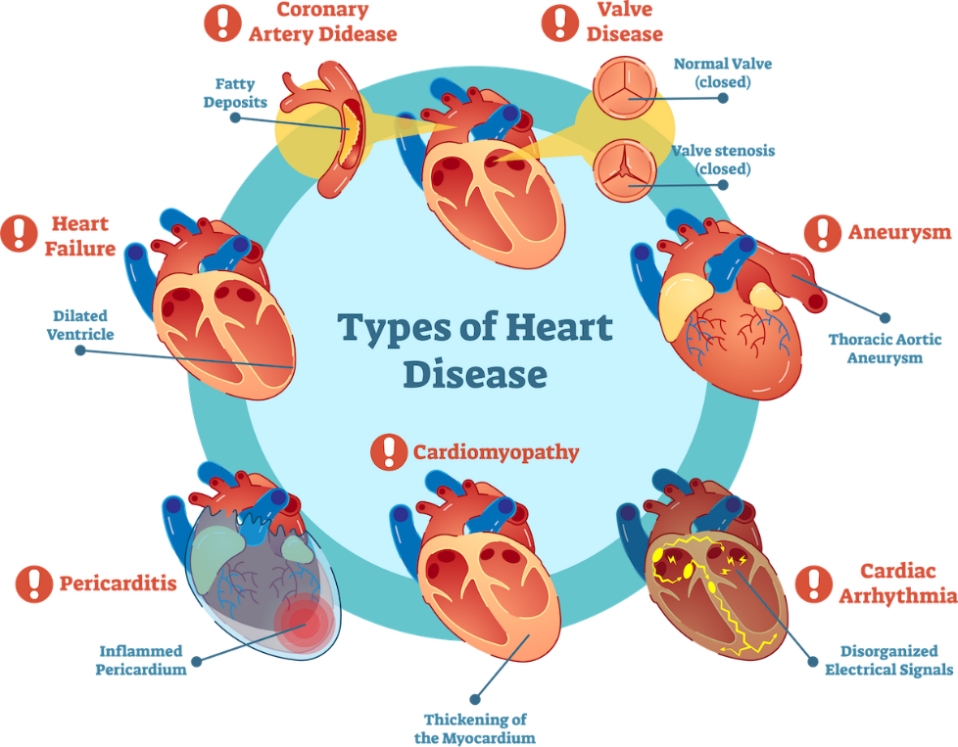
Introduction
Heart disease or cardiovascular disease describes a range of conditions that affect the heart
These are the leading cause of death globally
An estimated 17.9 million people died from heart diseases in 2019, representing 32% of all global deaths
It is important to detect cardiovascular disease as early as possible so that management with counselling and medicines can begin
But it has been noticed that it is difficult to identify heart diseases as there are multiple factors contributing such as high cholesterol, high blood pressure, diabetes, abnormal pulse rate and many more
Due to such complexities, people can adopt modern technology approaches like Machine Learning to predict the presence of the disease

Slide 4
Dataset
The Cleveland Heart Disease dataset was obtained from UCI Machine Learning data repository
https://archive.ics.uci.edu/ml/datasets/Heart+Disease
Attribute | Description
age | Display the age of the individual
sex | Displays the gender of the individual using the following format 1 = male; 0 = female
cp | displays the type of chest-pain experienced by the individual using the following format : 1 = typical angina; 2 = atypical angina; 3 = non-anginal pain; 4 = asymptotic
trestbps | Displays the resting blood pressure value of an individual in mmHg (unit)
chol | Displays the serum cholesterol in mg/dl (unit)
fbs | Compares the fasting blood sugar value of an individual with 120mg/dl. If fasting blood sugar > 120mg/dl then : 1 (true); else : 0 (false)
restecg | Displays resting electrocardiographic results 0 = normal; 1 = having ST-T wave abnormality; 2 = left ventricular hyperthrophy
Attribute | Description
thalach | Displays the max heart rate achieved by an individual
exang | Exercise induced angina. 1 = yes; 0 = no
oldpeak | ST depression induced by exercise relative to rest
slope | The slope of the Peak exercise ST segment. 1 = upsloping; 2 = flat; 3 = down sloping
ca | Number of major vessels (0–3) colored by flourosopy
thal | Displays the thalassemia. 3 = normal; 6 = fixed defect; 7 = reversible defect
reslt | Diagnosis of heart disease. Displays whether the individual is suffering from heart disease or not: 0 = absence; 1= present

Slide 5
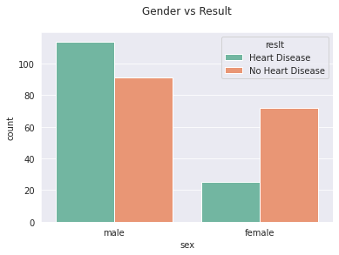
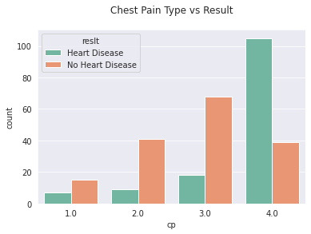
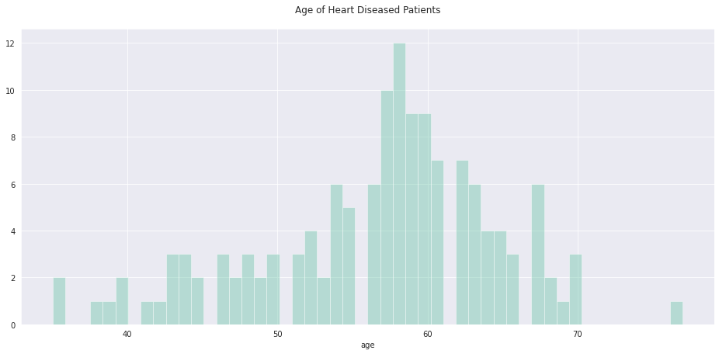
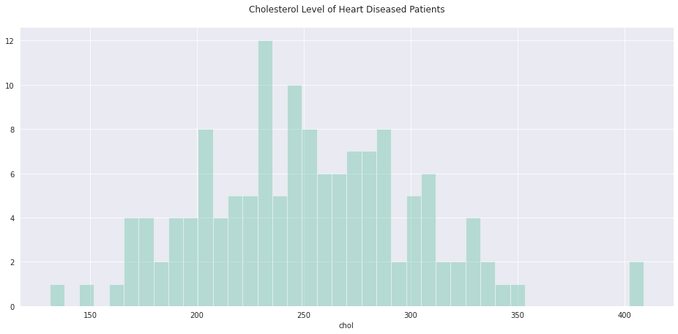
Data Visualization

Slide 6
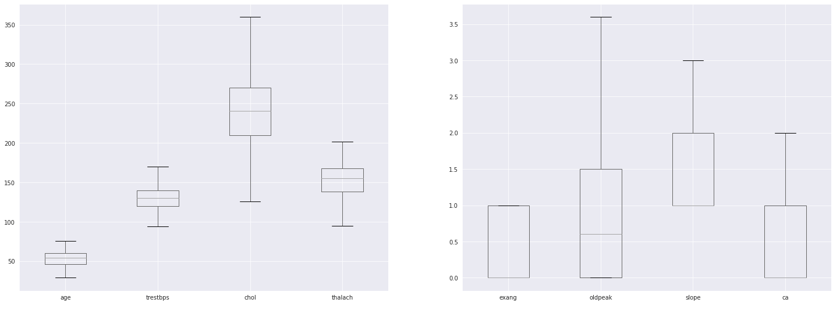
Data Analysis – Outliers & Missing Values
Outliers were found using Boxplots
Respective rows were dropped
Same treatment was followed for the missing values
Figure shows the Boxplots after removing the outliers

Slide 7
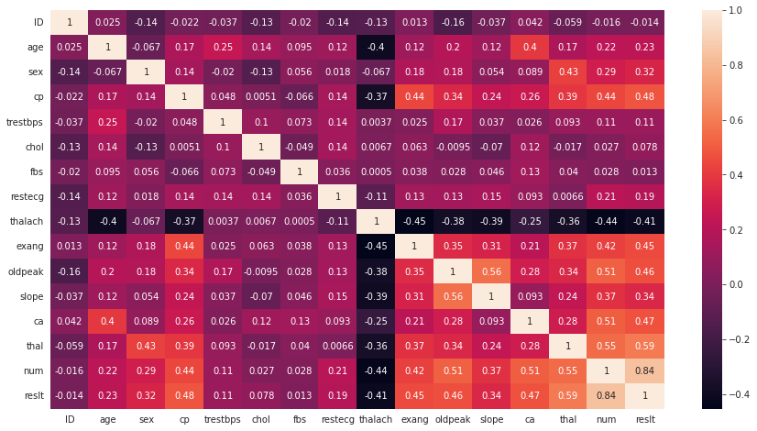
Data Analysis - Correlation
This shows the correlation of the attributes to one another
Highlights:
‘thalach’ is negatively correlated to ‘reslt’
‘thal’, ‘ca’, ‘oldpeak’, ‘exang’, ‘thalach, ‘cp’ are highly correlated to ‘reslt’

Slide 8

Machine Learning Model Training
User Data
Feature Variables (Training Data)
age, sex, cp, trestbps, chol, fbs, restecg, thalach, exang, oldpeak, slope, ca, thal
Supervised Classification Machine Learning Algorithms
Logistic Regression
KNeighbour
Random Forest
Decision Tree
Result
(Prediction)
Known Results
(Target Variable)
reslt (0: disease absent; 1: disease present)
Training
Infer
ML MODEL

Slide 9
Result
model | accuracy | precision | recall | f1_score | roc_auc
Logistic Regression | 0.902778 | 0.914286 | 0.902778 | 0.902759 | 0.925154
KNeighbors | 0.652778 | 0.677419 | 0.652778 | 0.651095 | 0.743441
Random Forest | 0.819444 | 0.870968 | 0.819444 | 0.818569 | 0.926312
Decision Tree (criterion=‘gini’) | 0.805556 | 0.805556 | 0.805556 | 0.805556 | 0.805556
Decision Tree (criterion='entropy’) | 0.805556 | 0.823529 | 0.805556 | 0.805405 | 0.805556
Logistic Regression was selected as the best model for heart disease prediction due to scoring matrices are above 0.9 and highest among others

Slide 10
Thank You

